Slide 1
AVL Trees
Adelson- Velsky - Landis

Slide 2
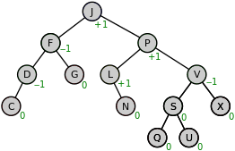
AVL Tree
AVL tree is a self-balancing binary search tree.
In an AVL tree
the heights of the two child subtrees of any node differ by at most one;
if heights differ by more than one, rebalancing is done to restore this property.

Slide 3
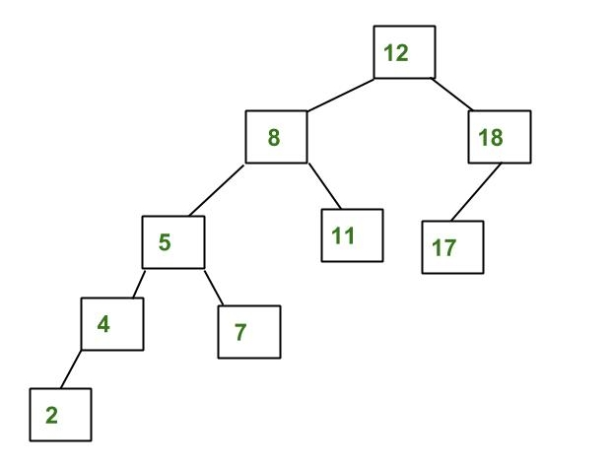
AVL Tree
Differences between heights of left and right subtrees
for every node is less than or equal to 1
Tree is not AVL
differences between heights of left and right subtrees for 8 and 12 is greater than 1

Slide 4
Why AVL Trees?
Most of the BST operations (e.g., search, max, min, insert, delete.. etc) take O(h) time where h is the height of the BST.
The cost of these operations may become O(n) for a skewed Binary tree.
For Balanced tree
The height of the tree remains O(Logn).
After every insertion and deletion, we can guarantee an upper bound of O(Logn)
Thus, height of an AVL tree is always O(Logn) where n is the number of nodes in the tree.

Slide 5
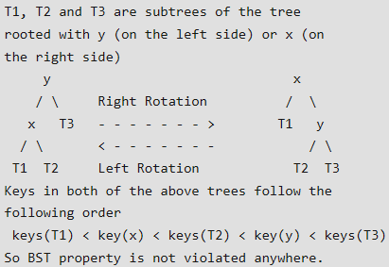
Insertion
To make sure that the given tree remains AVL after every insertion, we must augment the standard BST insert operation to perform some re-balancing.
Following are two basic operations that can be performed to re-balance a BST without violating the BST property (keys(left) < key(root) < keys(right)). 1) Left Rotation
2) Right Rotation

Slide 6
Node insertion in AVL tree
Steps to follow for insertion Let the newly inserted node be w 1) Perform standard BST insert for w.
2) Starting from w, travel up and find the first unbalanced node.
Let z be the first unbalanced node,
y be the child of z that comes on the path from w to z.
x be the grandchild of z that comes on the path from w to z
3) Re-balance the tree by performing appropriate rotations on the subtree rooted with z.
There can be 4 possible cases that needs to be handled as x, y and z can be arranged in 4 ways.
a) y is left child of z and x is left child of y (Left Left Case) b) y is left child of z and x is right child of y (Left Right Case) c) y is right child of z and x is right child of y (Right Right Case) d) y is right child of z and x is left child of y (Right Left Case)
In all of the cases, we only need to re-balance the subtree rooted with z and the complete tree becomes balanced as the height of subtree (After appropriate rotations) rooted with z becomes same as it was before insertion.

Slide 7
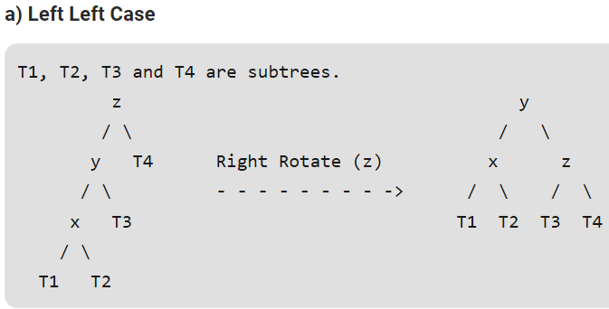

Slide 8
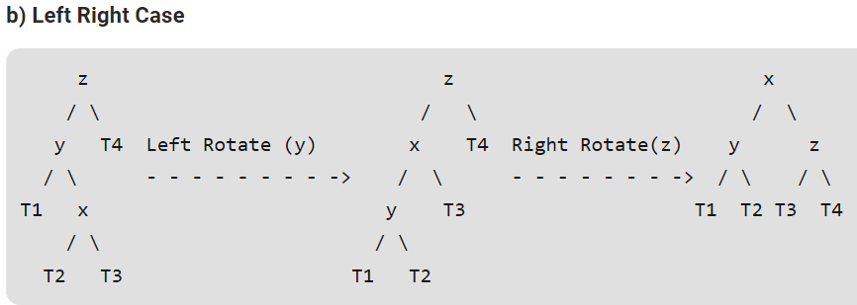

Slide 9
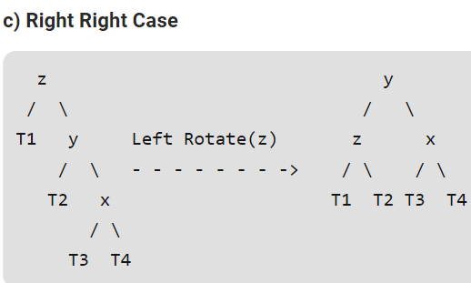

Slide 10
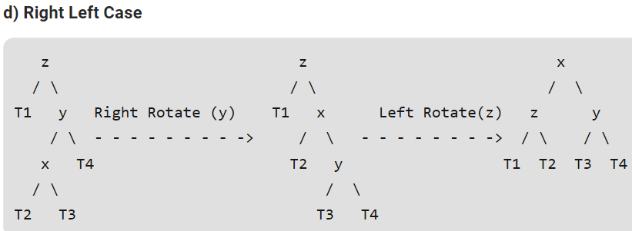

Slide 11
Following are the operations to be performed in above mentioned 4 cases

Slide 12
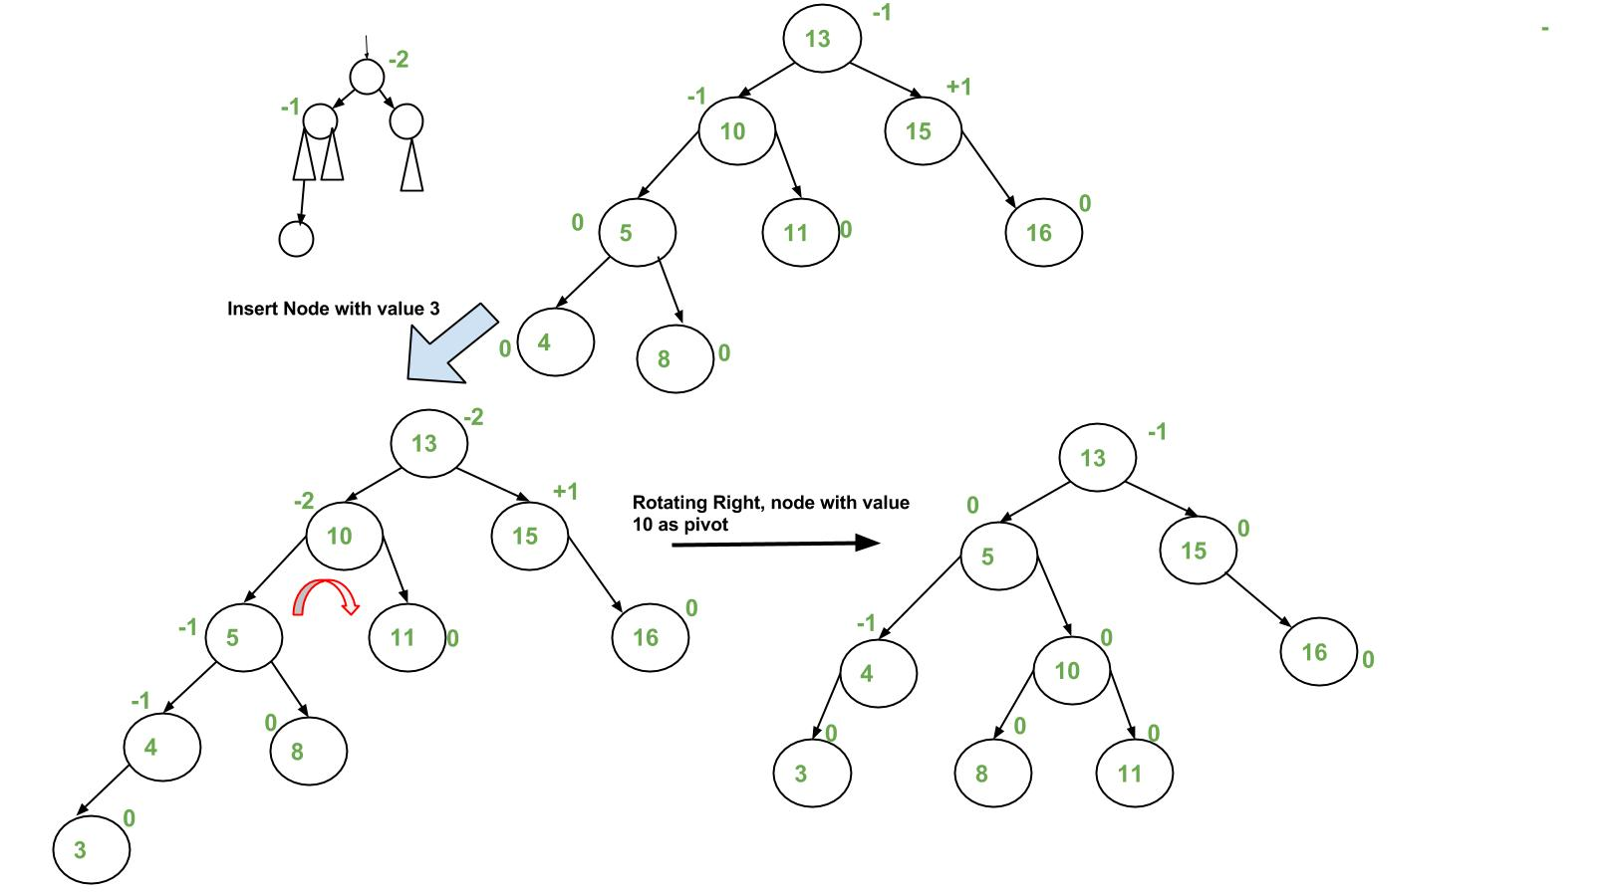

Slide 13
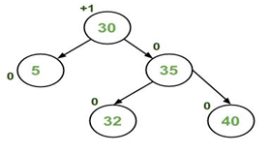
Insert 45

Slide 14
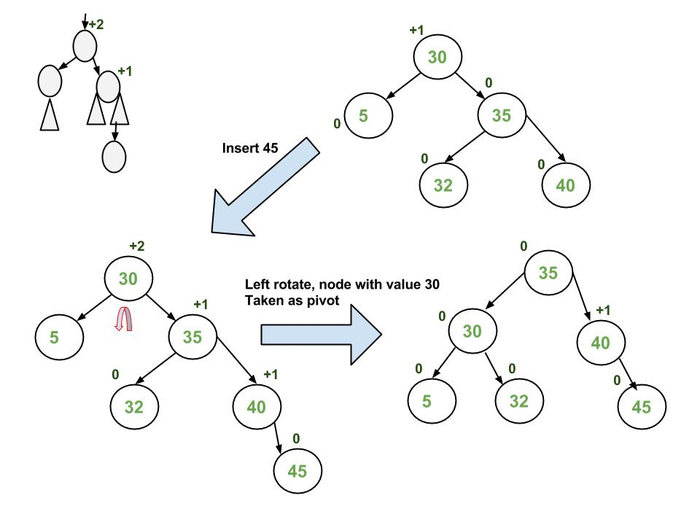

Slide 15
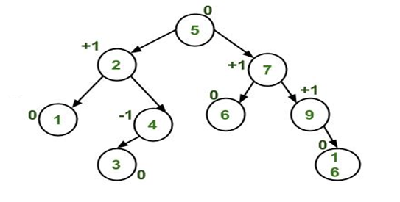
Insert 15

Slide 16
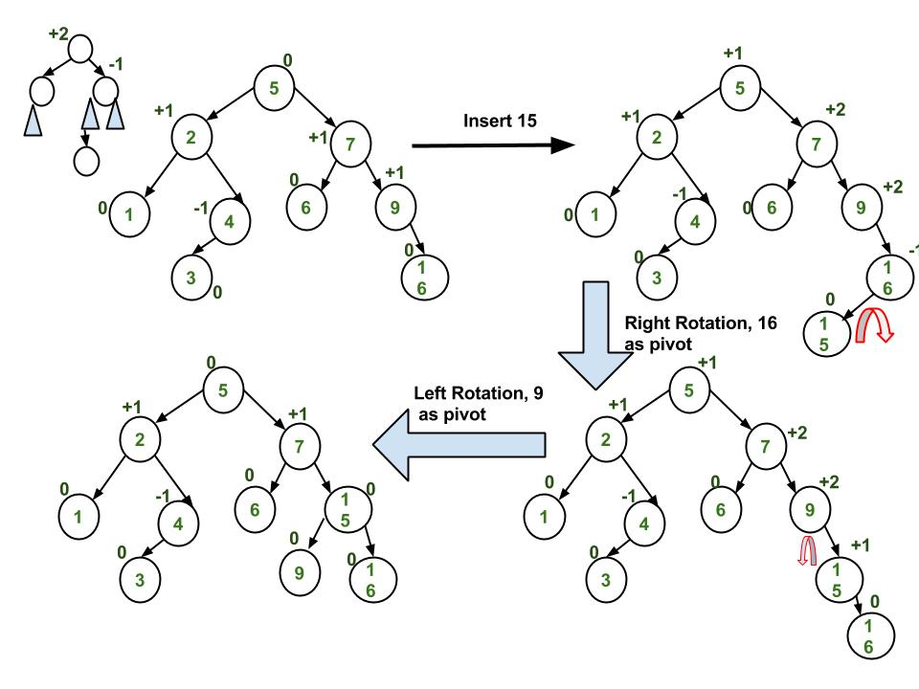

Slide 17
Insert following keys in an AVL tree
45, 32, 46, 12, 23,

Slide 18
Deletion in AVL Tree
Deleting a node from an AVL tree is similar to that in a binary search tree.
Deletion may disturb the balance factor of an AVL tree and therefore the tree needs to be rebalanced in order to maintain the AVLness.
The two types of rotations are L rotation and R rotation
Let us consider that,
A is the critical node and
B is the root node of its left sub-tree.
If node X, present in the right sub-tree of A, is to be deleted, then there can be three different situations:

Slide 19
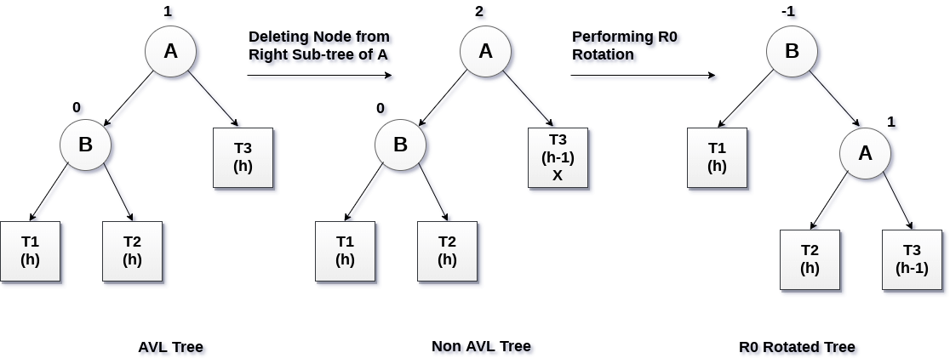
R0 rotation (Node B has balance factor 0 )
If the node B has 0 balance factor, and the balance factor of node A disturbed upon deleting the node X, then the tree will be rebalanced by rotating tree using R0 rotation.
R0 → LL Case → Right Rotation at critical node

Slide 20
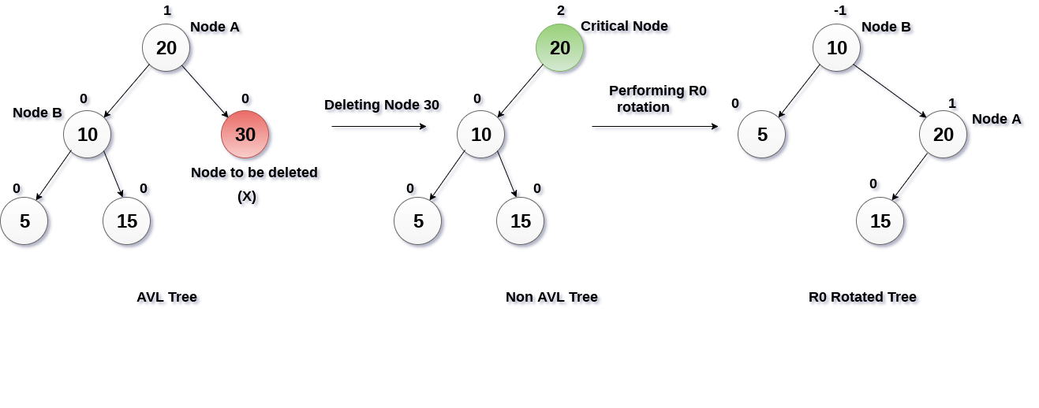
Example R 0

Slide 21
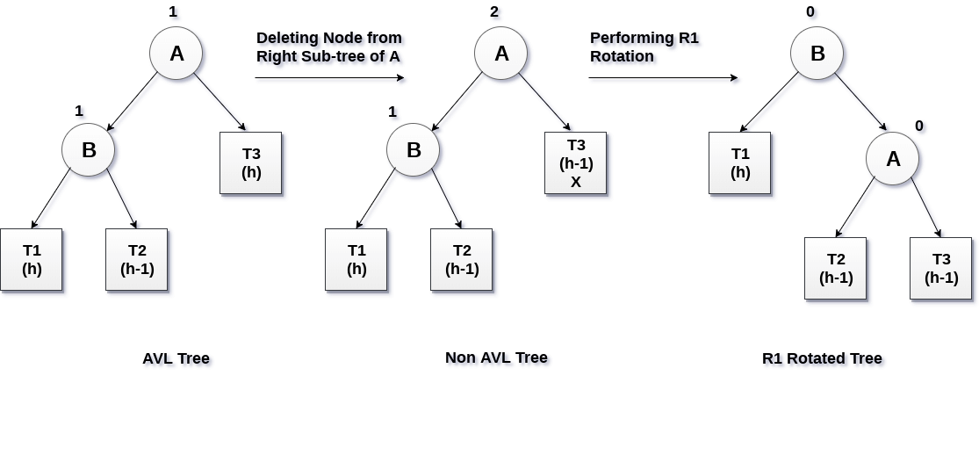
R1 Rotation (Node B has balance factor 1)
R1 Rotation is to be performed if the balance factor of Node B is 1.
In R1 rotation, the critical node A is moved to its right having sub-trees T2 and T3 as its left and right child respectively. T1 is to be placed as the left sub-tree of the node B.
R1 → LL Case → Right Rotation at critical node

Slide 22
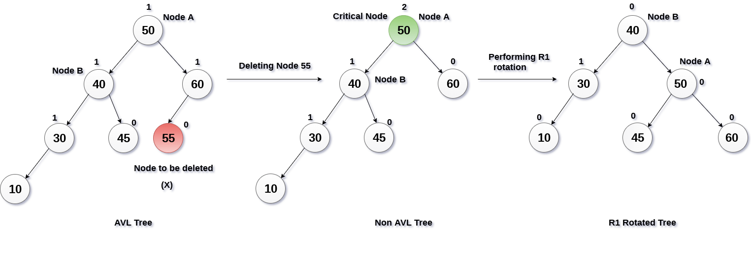
Example R 1

Slide 23
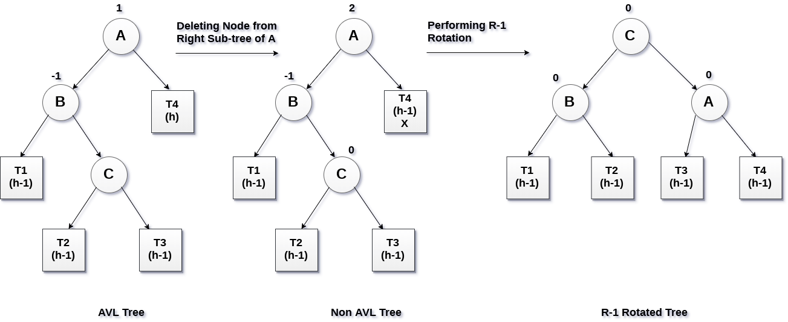
R -1 Rotation (Node B has balance factor -1)
R-1 rotation is to be performed if the node B has balance factor -1.
This case is treated in the same way as LR rotation.
In this case, the node C, which is the right child of node B, becomes the root node of the tree with B and A as its left and right children respectively.
R-1 → LR Case → Left Rotation at B and then Right Rotation at critical node(A)

Slide 24
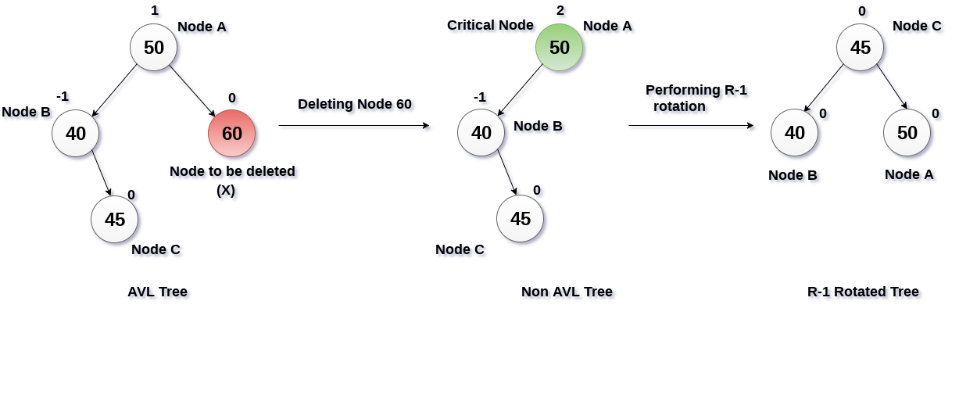
Example R-1

Slide 25
Summary
In deletion of any node in AVL tree, The two types of rotations can be made .
They are L rotation and R rotation.
As R rotations are discussed in previous slide. L rotations are the mirror images of them.
R rotations
R0 → LL Case
R1 → LL case
R -1 → LR case
L rotations
L0 → RR Case
L1 → RR Case
L -1 → RL Case
{Note – for rotation check previous Balance factor with sibling}

Slide 26
Rules of Rotation
IF using L-R for balancing Factor, then
R - Rotations L - Rotations
R0 = LL Case L0 = RR Case
R1 = LL case L1 = RL Case
R -1 = LR case L -1 = RR Case
IF using R - L for balancing Factor, then
R - Rotations L - Rotations
R0 = LL Case L0 = RR Case
R -1 = LL case L-1 = RL Case
R 1 = LR case L1 = RR Case
From Symmetry, we can derive other Rotation as well.
Note
R Rotations in L-R will be a mirror case of L rotation in R-L
Ex
if BF = L-R
R - Rotations
R0 = LL Case
R1 = LL case
R -1 = LR case
Then for BF in R-L will be
L0 = RR Case
L-1 = RL Case
L1 = RR Case
and likewise other cases can be derived easily

Slide 27
Construct AVL Tree
Insert
12, 19, 17, 6, 18, 13, 25, 36, 80
Delete
17, 6, 18, 12

Slide 28
Construct AVL Tree
Insert
14, 11, 19, 7, 12, 17, 53, 4, 8, 13, 20, 60, 70
Delete
8, 7, 11, 14, 17

Slide 29
Video Lectures of this topic can be found at following link
Introduction to AVL Trees & ADDING Node to it
https://youtu.be/e0fv6J4xB9k
How to DELETE Node from a AVL Tree
https://youtu.be/YaqRywXnubo
Illustrative Example of ADDING & DELETING NODE in AVL Tree
https://youtu.be/N8EyWlBP4tM

